Slide 1
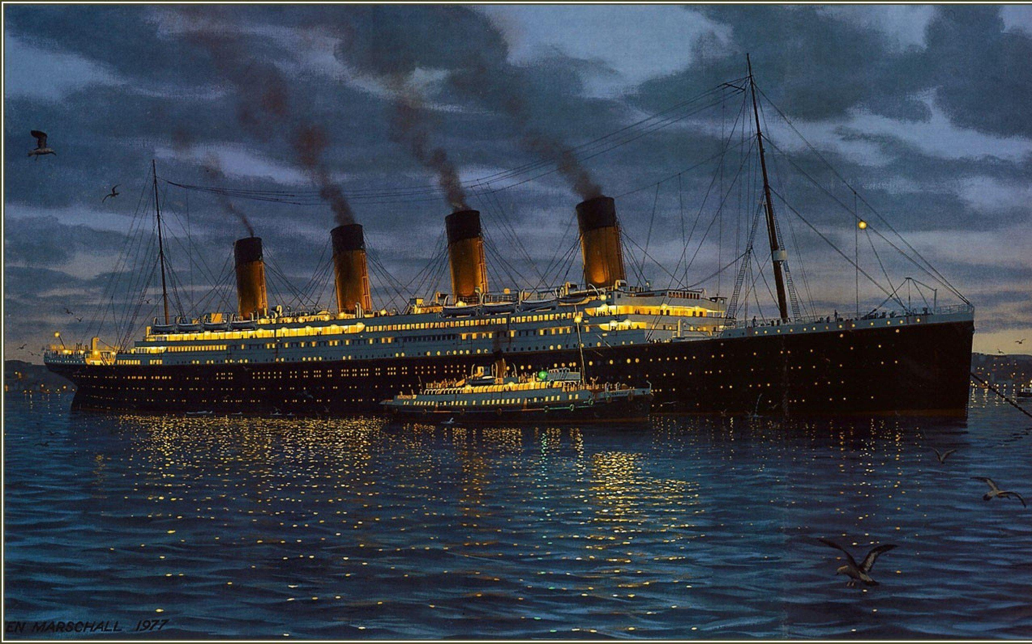

Titanic project
Python
B.Anjalika

Slide 2
Data Dictionary
Variable | Definition | Key
Survival | Survival | 0 = No, 1 = Yes
Pclass | Ticket class | 1 = 1st, 2 = 2nd, 3 = 3rd
Sex | Sex
Age | Age in years
SibSp | # of siblings / spouses aboard the Titanic
Parch | # of parents / children aboard the Titanic
Ticket | Ticket number
Fare | Passenger fare
Cabin | Cabin number
Embarked | Port of Embarkation | C = Cherbourg, Q = Queenstown, S = Southampton

Slide 3
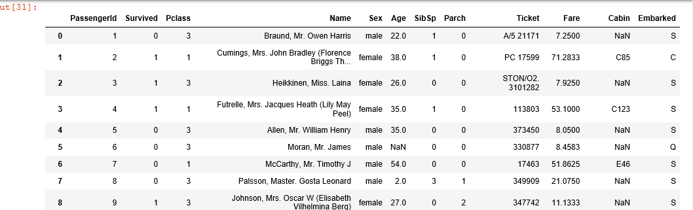
Importing Necessary Libraries and datasets
# Load necessary libraries
import pandas as pd
import numpy as np
import matplotlib.pyplot as plt
%matplotlib inline
Loading Dataset
# Read Titanic Dataset
titanic = pd.read_csv('titanic_train.csv')
titanic

Slide 4
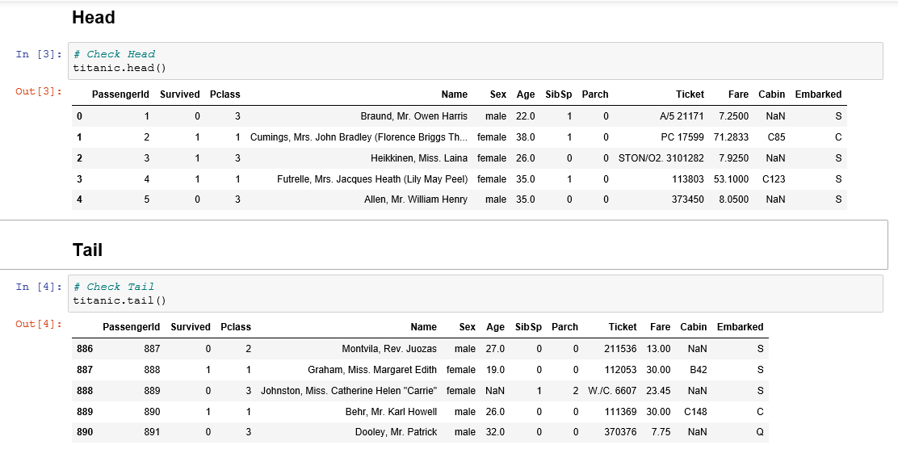
A Glimpse of the Datasets

Slide 5
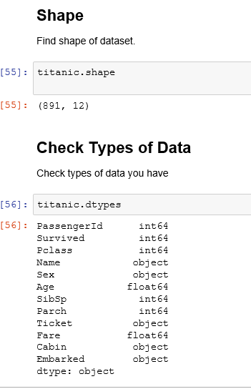

Slide 6
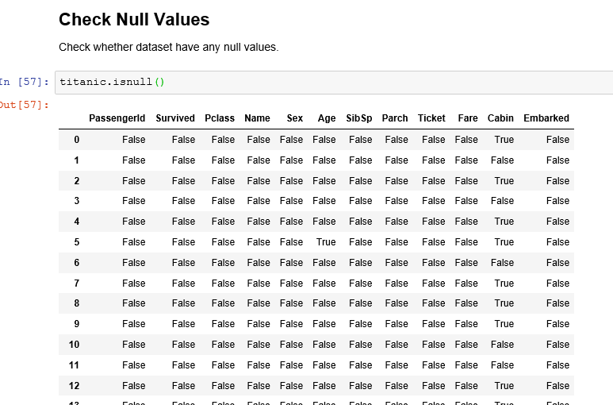
Dealing with Missing values

Slide 7

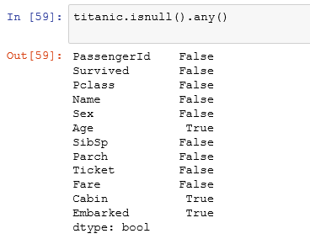
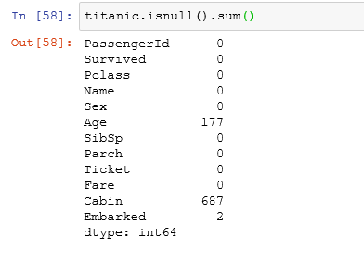

Slide 8

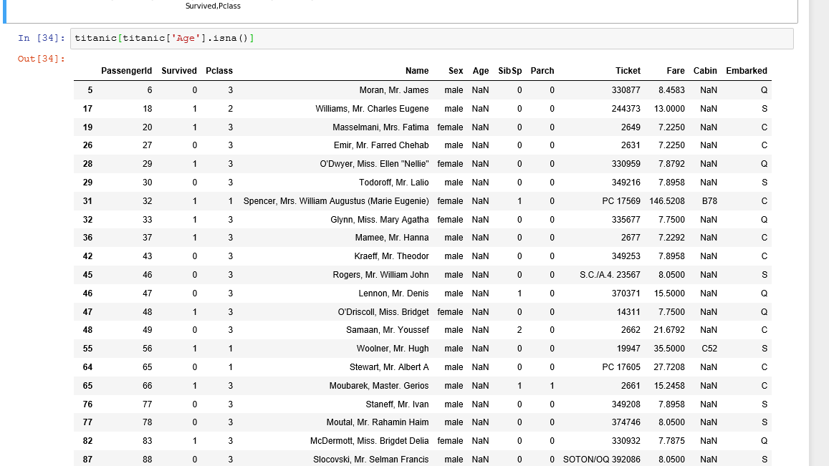
Fill Null Values
Is there any null values in any columns?
Identify those columns

Slide 9

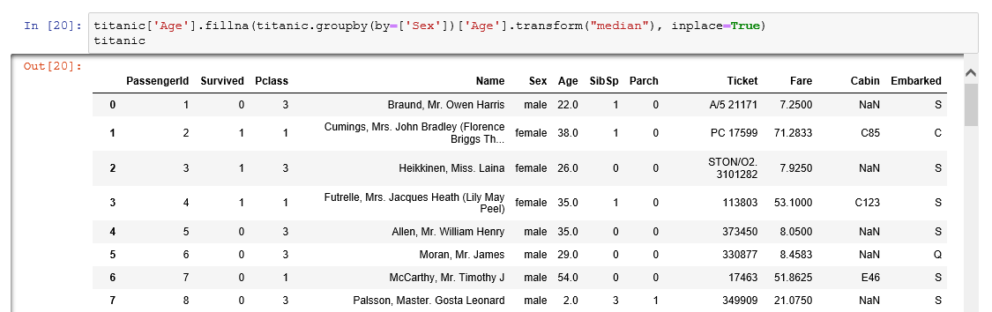

Slide 10
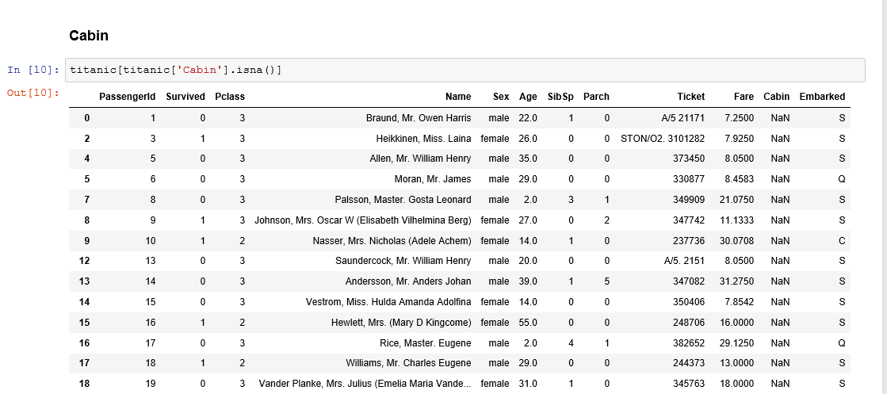
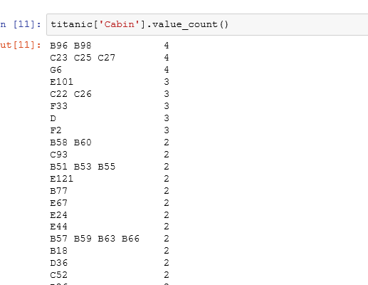
Reshaping

Slide 11

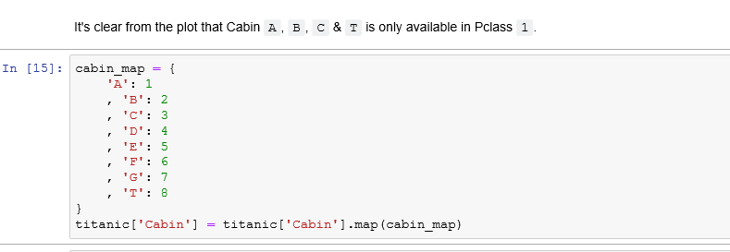
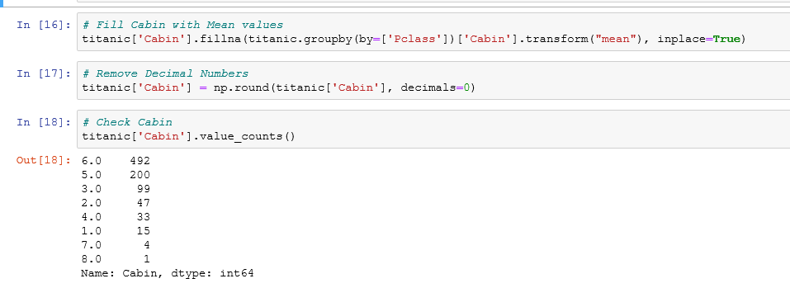

Slide 12
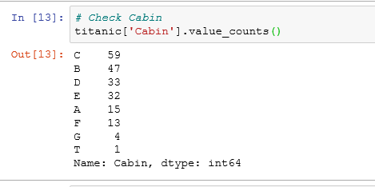
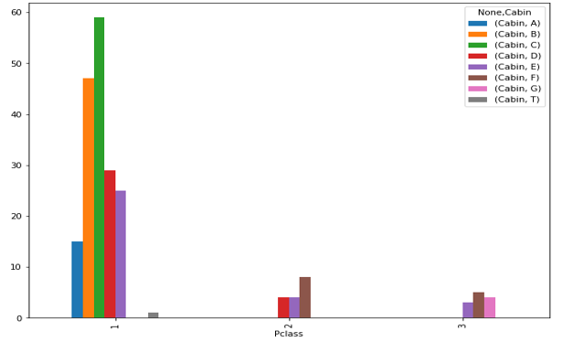
Visualization and Feature Relations

Slide 13

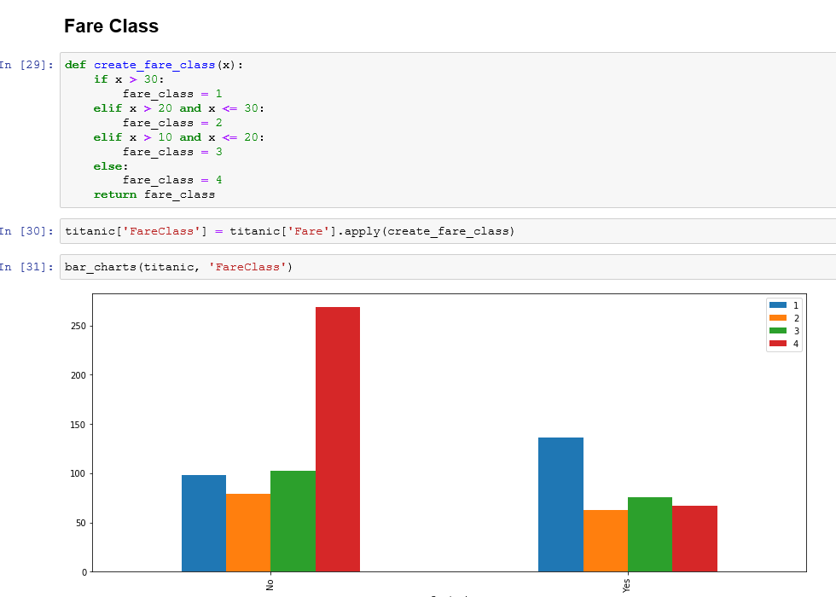
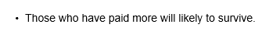

Slide 14

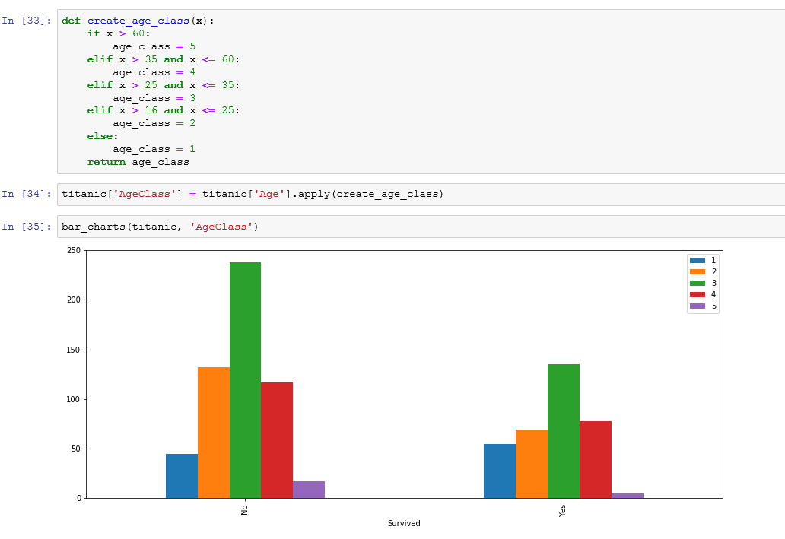

Slide 15
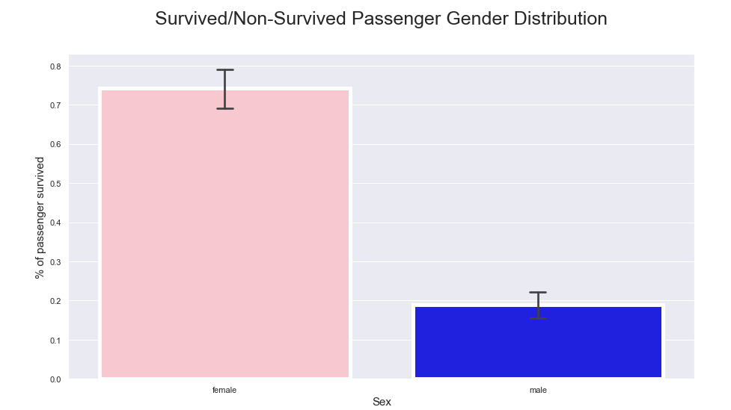
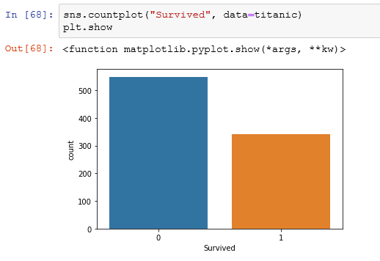
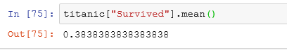
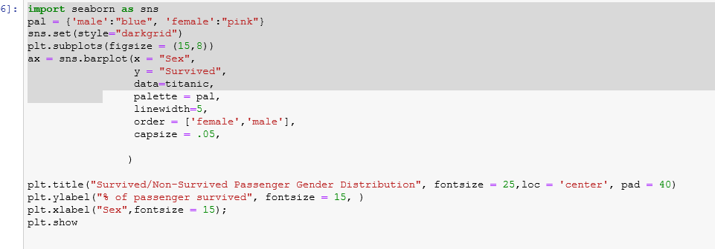


Slide 16
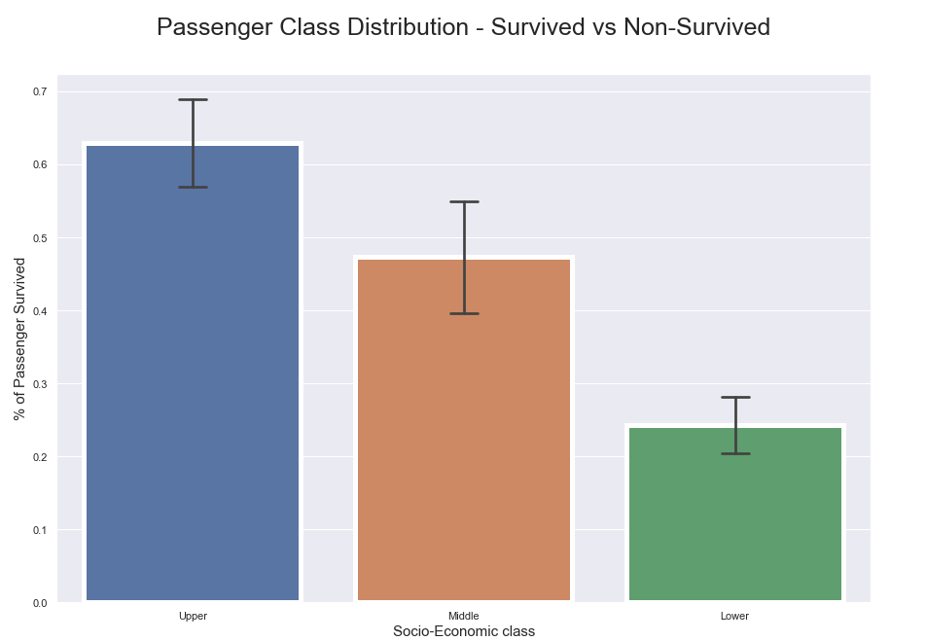
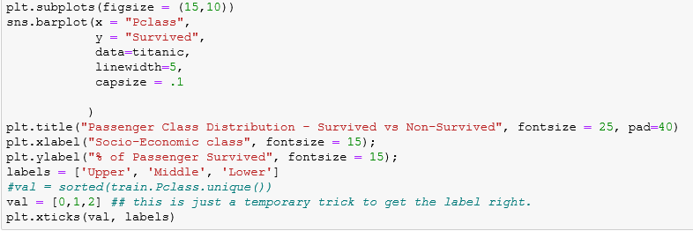

Slide 17
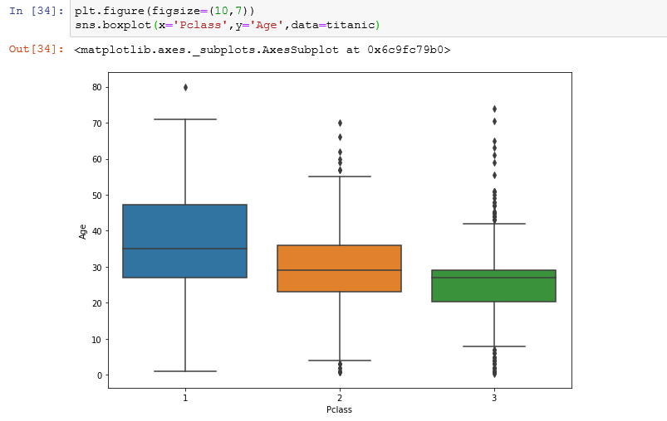


Slide 18
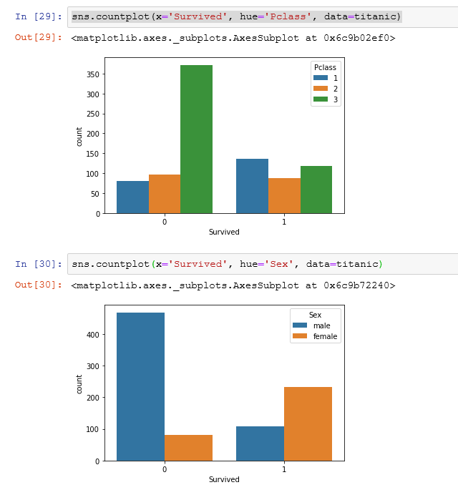

Slide 19
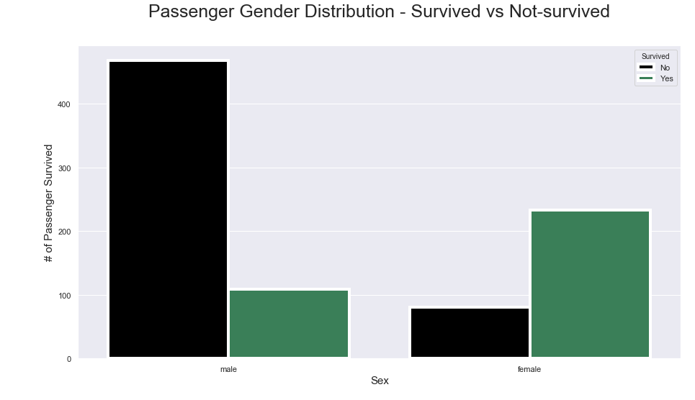
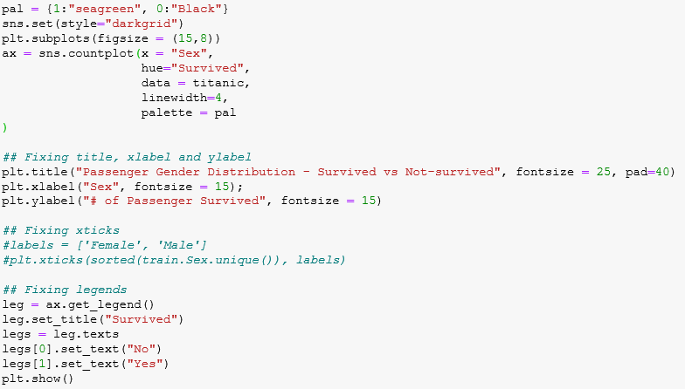

Slide 20
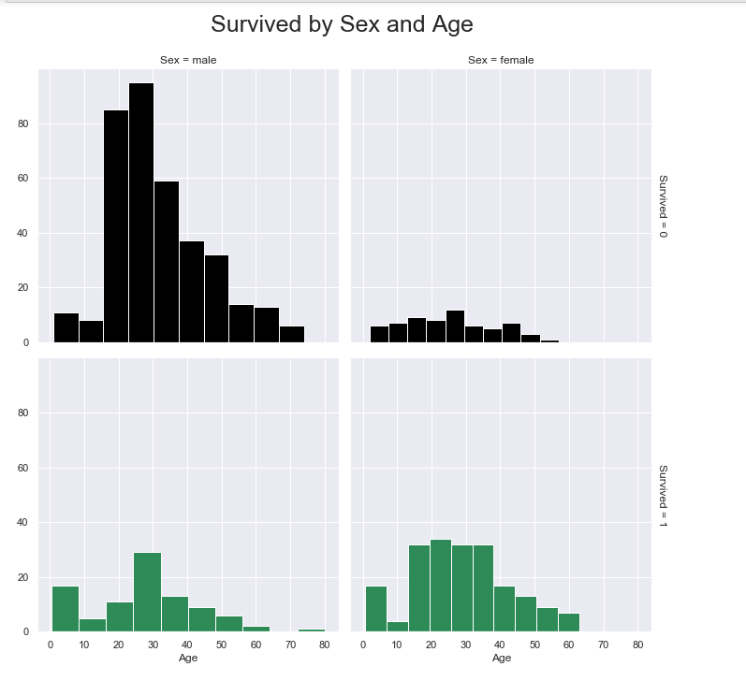

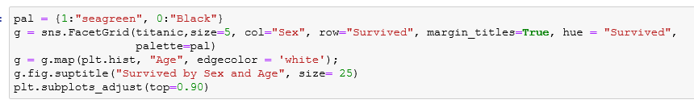

Slide 21
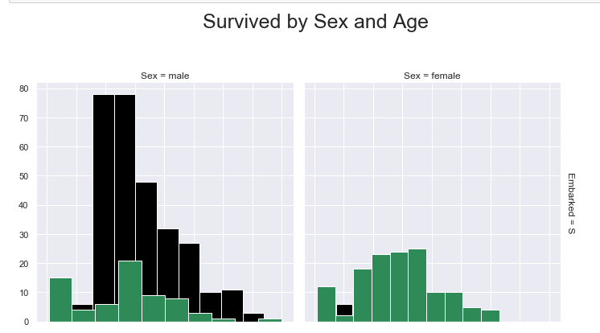
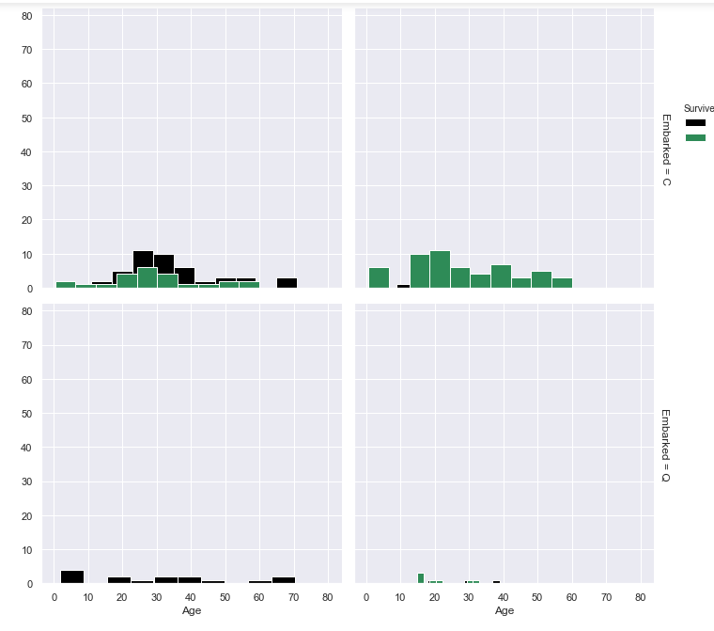
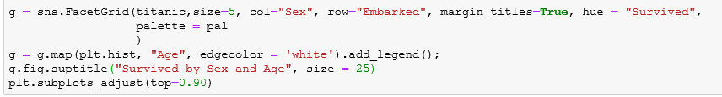
Combined Feature Relations

Slide 22
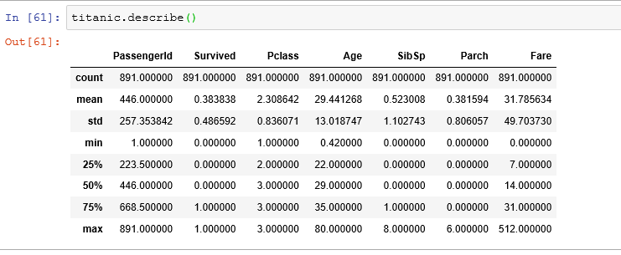
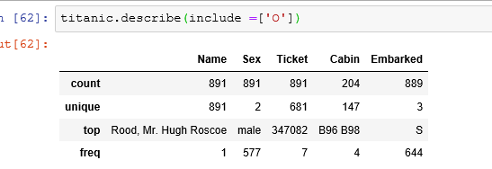
Statistical Overview

Slide 23
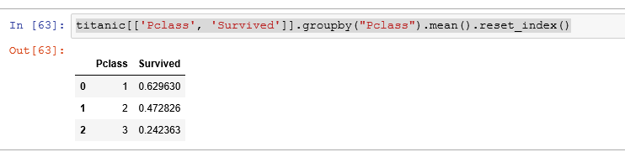

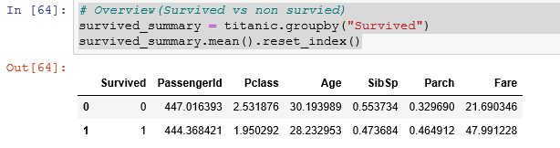
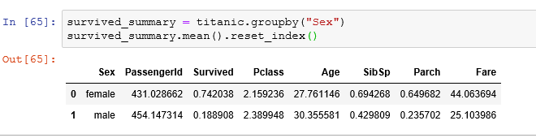
Summary
This data set has 891 raw and 9 columns.
only 38% passenger survived during that tragedy.
~74% female passenger survived, while only ~19% male passenger survived.
~63% first class passengers survived, while only 24% lower class passenger survived.
https://www.kaggle.com/masumrumi/a-statistical-analysis-ml-workflow-of-titanic#Part-4:-Statistical-Overview

Slide 24
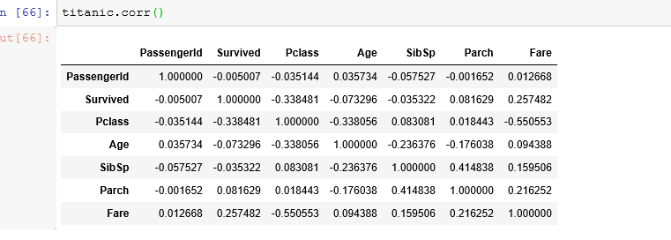
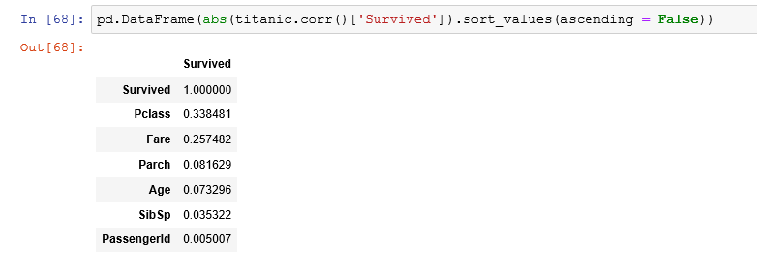
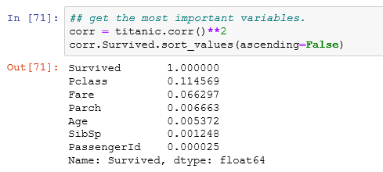
Correlation
correlation between survived and other features
Sex is the most important correlated feature with Survived(dependent variable) feature followed by Pclass.
Squaring the correlation feature not only gives on positive correlations but also amplifies the relationships.

Slide 25
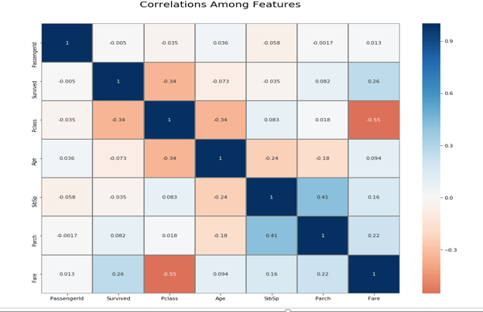
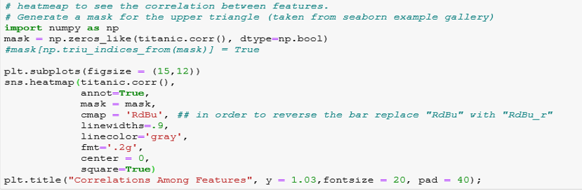
Positive Correlation Features:
Fare and Survived: 0.26
Negative Correlation Features:
Fare and Pclass: -0.6
Sex and Survived: -0.55
Pclass and Survived: -0.33

Slide 26
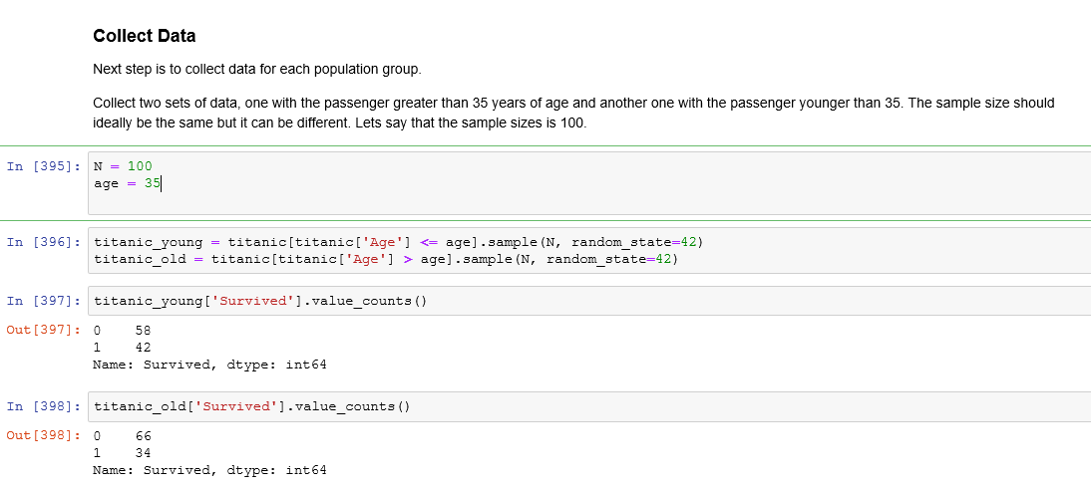
Null Hypothesis (H0): There is no difference in the survival rate between the young and old passengers.
Alternative Hypothesis (HA): There is a difference in the survival rate between the young and old passengers.

Slide 27
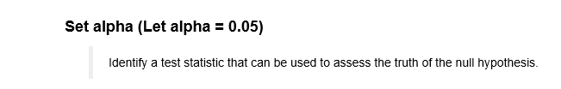
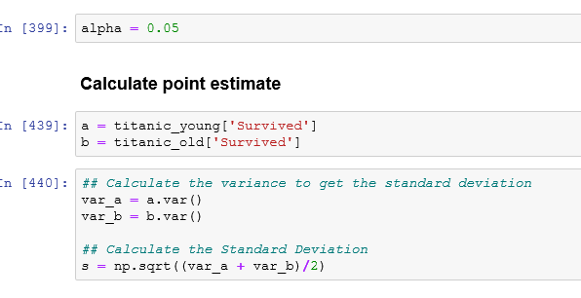
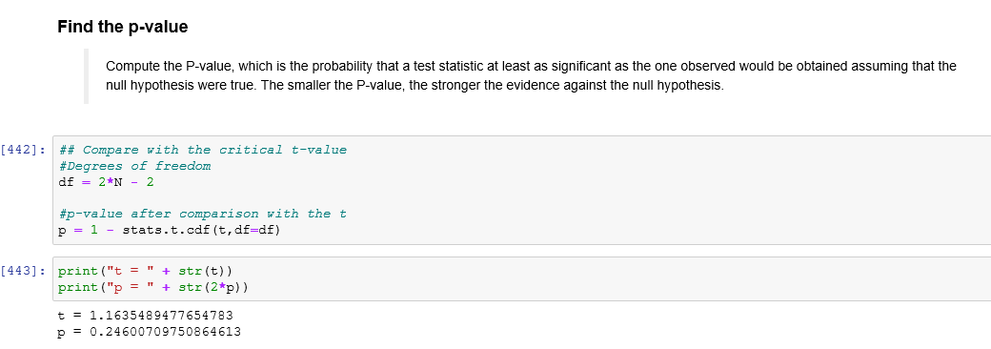
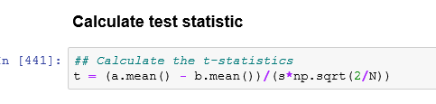

Slide 28
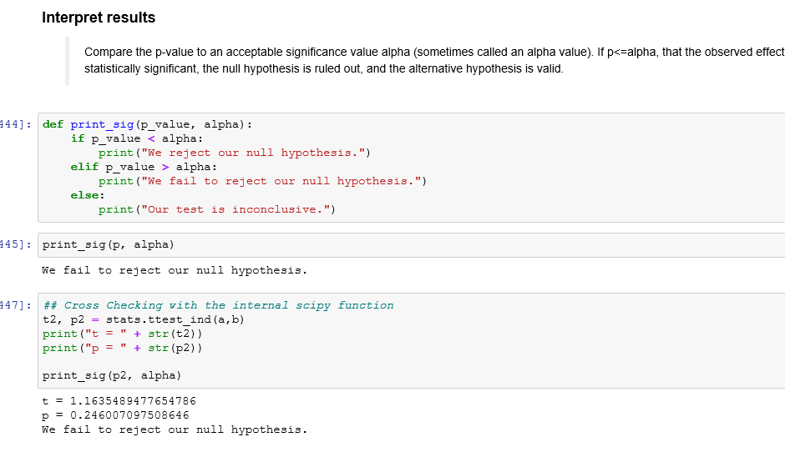

Slide 29



Thank You
https://www.kaggle.com/masumrumi/a-statistical-analysis-ml-workflow-of-titanic/notebook

